Slide 1
Auditing and Assurance Update on Non-Financial Information (NFI)
Date March 22, 2019
Presented by:
Liv A. Watson
Sr. Director of Strategic Customer Initiatives
The 44th World Continuous Auditing & Reporting Symposium

Slide 2
Connect Your Data, Trust Your Reports

Slide 3
How do professional accountants respond to the growing demand for assurance on digital non-financial information (NFI)?

Slide 4
Definition of Non-Financial Data?
A Question?
What if a natural capital resource has a material impact on the financial statement ,,,
"is the natural capital financial or non-financial data point?"

Slide 5
Agenda
1
Current Situation & Challenges
2
Market Drivers
3
Market Initiatives
4
Research Topics
5
Q & A

Slide 6
Current Situation and Current Challenges
Continuous Risk Monitoring and Assessment (CRMA)
Continuous Controls Monitoring (CCM)
Continuous
Auditing
Continuous
Data
Assurance
(CDA)

Slide 7
My Current Situation is NOT
My Final Destination !
Audit and Assurance Faculty
Entities regularly report non-financial information, including:
Statements and information contained in the annual report, such as the enhanced business review, corporate governance statements and information on risk management policies, internal controls or wider operating data
Corporate responsibility reporting (CSR) on environmental, economic and social performance or Integrated Reporting <IR>
Reports to regulators on matters such as risk exposures, pricing policies or compliance with regulatory requirements
Reporting on public interest concerns, for example, quality of service provision, carbon emissions or the conduct of public competitions.
Note: In the UK and Germany it is a criminal offence on the part of the directors not to prepare and publish the nonfinancial information statement in accordance with the relevant requirements.

Slide 8
My Current Situation is NOT
My Final Destination !
What does the Standards Say?
ISA™ 720 (Revised), The Auditor’s Responsibilities Relating to Other Information
1. ISA™ 720 (Revised) deals with the auditor’s responsibilities relating to other information in documents containing audited financial statements and the auditor’s report thereon.
In the absence of any separate requirement in the particular circumstances of the engagement, the auditor’s opinion does not cover other information and the auditor has no specific responsibility for determining whether or not other information is properly stated.
However, the auditor reads the other information because the credibility of the audited financial statements may be undermined by material inconsistencies between the audited financial statements and other information. (Ref: Para. A1)
Note: Other information is financial or non-financial information (other than financial statements and the auditor’s report thereon, included in an entity’s annual report.

Slide 9
My Current Situation is NOT
My Final Destination !
Standards
ISA™ 720 Definition of Other Information
2. “Documents containing audited financial statements” refers to annual reports (or similar documents), that are issued to owners (or similar stakeholders), containing audited financial statements and the auditor’s report thereon.
This may also be applied, adapted as necessary in the circumstances, to other documents containing audited financial statements, such as those used in securities offerings.1 (Ref: Para. A2)
Note: Effective Date: Audits of financial statements for periods ending on or after December 15, 2016

Slide 10
Current Drivers - EU Regulated Non-Financial Discourse Requirements
October
2018
15 April
2014
The FRC's ANNUAL REVIEW OF CORPORATE GOVERNANCE AND REPORTING.. announces that FRC expect disclosure for non-financial data to focus on the impact of its activities in respect of these matters, the policies it has in place, any due diligence processes introduced through which it assesses and tracks their effectiveness and the related outcomes.
22 October
2014
1 January
2017
The plenary of the European Parliament adoption the EU Directive 2014/95/EU
The Directive was published in the EU Official Journal
The first reporting year
June
2014
6 December
2016
July
2018
The Directive prescribes that information must be
provided to the ‘extent necessary for an understanding
of the company’s development, performance and
position and the impact of its activity’
The UK Financial Reporting Council (FRC) published the "Guidance on the Strategic Report" which encouraged companies to facilitate communication and engagement with investors by publishing moire relevant narrative reports.
EU Directive by which it must be transposed into UK National Legislation / Companies Act 2006 requirements for the Strategic Report and include diversity
requirements in the Disclosure and Transparency Rules (DTR).
The UK Financial Reporting Council (FRC) publishes a substantive revisions update to the "Guidance on the Strategic Report" / Effective Date: Accounting periods starting on or after 1 January 2019. The changes are designed to bring about a shift in focus and improve openness and transparency, the hallmarks of good governance and reporting of non-financial information .
Note: EU Members country’s option to have the NFI “verified” by an independent assurance service provider.

Slide 11
What will be communicated in the auditor’s report ?
Note: The following is an example of reporting when the auditor has obtained all of the other information prior to the date of the auditor's report and has not identified a material misstatement of the other information.
Other Information [or another title if appropriate, such as “Information Other than the Financial Statements and Auditor’s Report Thereon”] Management is responsible for the other information. The other information comprises the [information included in the X report, + but does not include the financial statements and our auditor’s report thereon.]
Our opinion on the financial statements does not cover the other information and we do not express any form of assurance conclusion thereon.
In connection with our audit of the financial statements, our responsibility is to read the other information and, in doing so, consider whether the other information is materially inconsistent with the financial statements or our knowledge obtained in the audit, or otherwise appears to be materially misstated. If, based on the work we have performed, we conclude that there is a material misstatement of this other information, we are required to report that fact.
We have nothing to report in this regard.
Note: A more specific description of the other information, such as “the management report and chairman’s statement,” may be used to identify the other information.
The Directive 2014/95/EU allows Member States to impose state specific requirements on companies regarding the three key aspects of reporting:
Reporting
Framework
Disclosure
Format
Reporting
Content
International
Reporting
Framework
Management
Reports
Safe Harbour Principles
Separate Reports or <IR>
EU-based
Framework
Industry Specific
Reports
National
Reporting
Framework
Stakeholder
Communications
Stastitics

Slide 12
Current Challenges
Maturity of the company’s reporting processes
Define the scope of the assurance engagement
Assess the subject matter
Assess the reporting criteria
Assess materiality
Form of the assurance report
1
2
3
4
5
6

Slide 13
Non-Financial Information (NFI) Market Tends
Green Economies
Market Trends
A tougher stance from policymakers
&
Regulators
A rapid increase in non-financial regulations
Green Investors
Green Consumer
Harmonization of Standard Setters
Harmonization of Statistics

Slide 14
Non-Financial Information (NFI) Market Initatives
A Societal Framework

Slide 15
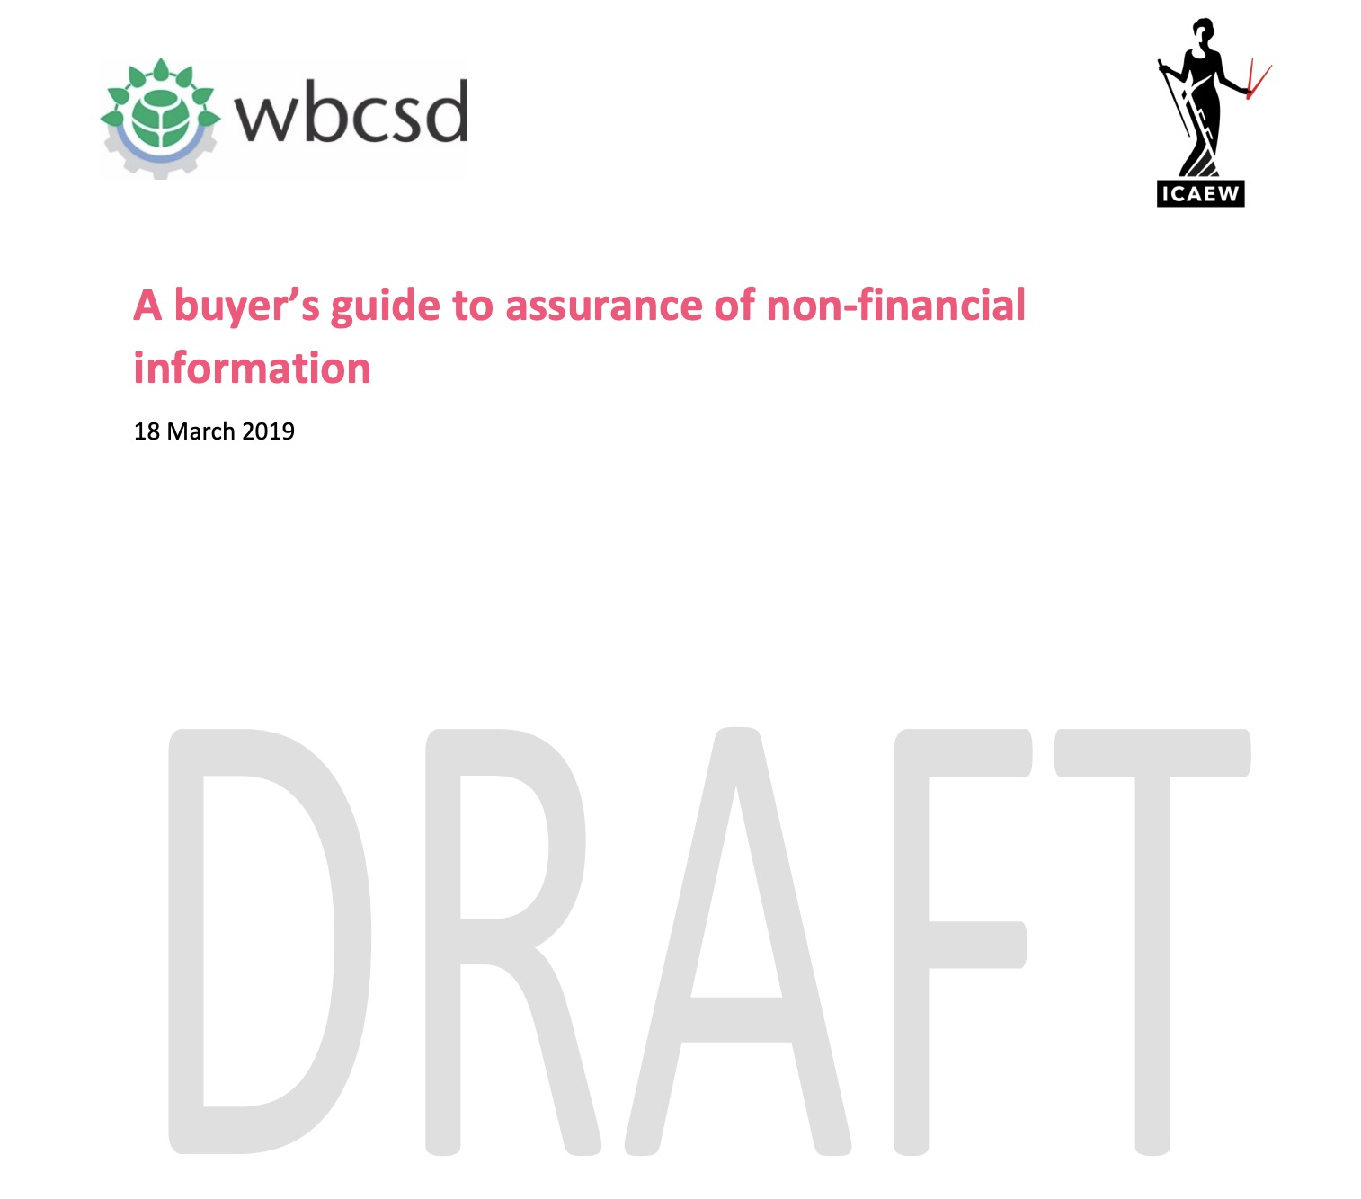
In Italy and France, for example, obtaining assurance on the non-financial statement is now a legal requirement.
The World Business Council for Sustainable Development
"explain, in simple terms, what assurance is, how the process of assurance works and set out the key considerations for companies seeking to procure assurance services that are ‘fit for purpose."
Note: WBCSD is CEO-led organization of over 200 international companies

Slide 16
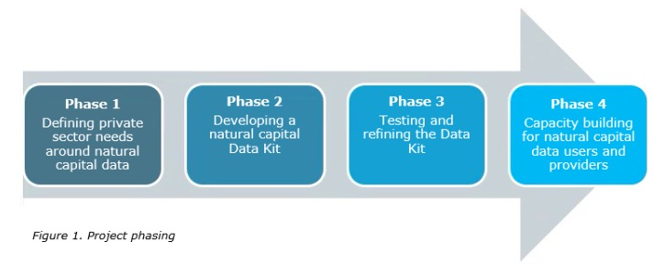
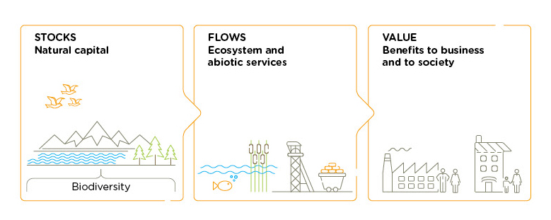
Data Information Flow Project
‘data barriers’
Key questions
How should we define natural capital ‘data’?
What are the boundaries of what is included?
What are the core data needs, gaps and opportunities for business and how can existing data be made more available to decision makers?
What should be the guiding principles for an improved global natural capital data system?
Source: https://naturalcapitalcoalition.org/projects/data-kit/

Slide 17
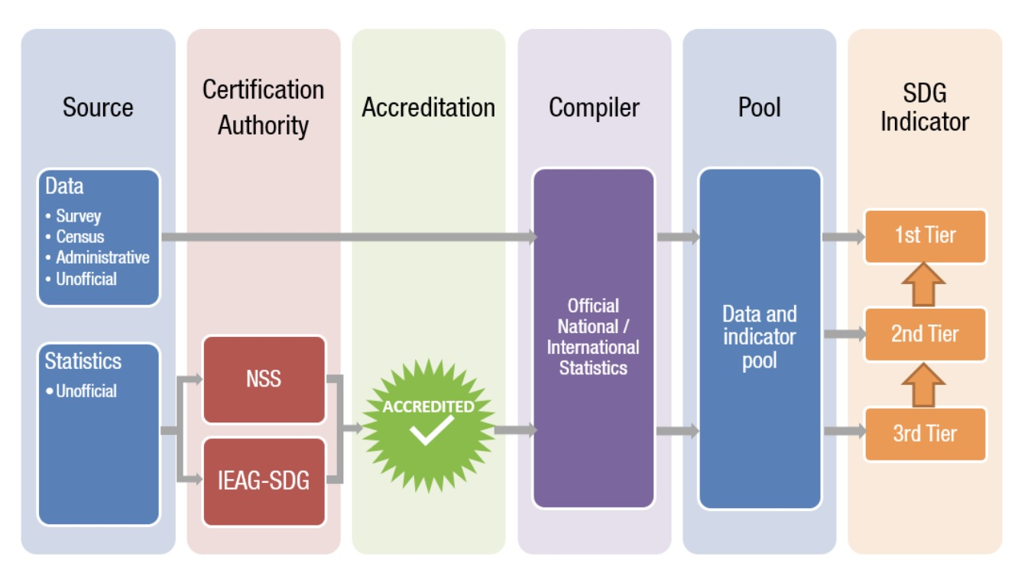
To keep track of the SDGs, we need a data revolution!!!
Is there another way to solve this problem?
We propose that a body with the authority and competence to certify statistics as “fit for purpose” should be mandated by the United Nations.
Steve MacFeely Chief Statistician, UNCTAD

Slide 18
The XBRL International NON-FINANCIALS REGISTRY TASK FORCE

Slide 19
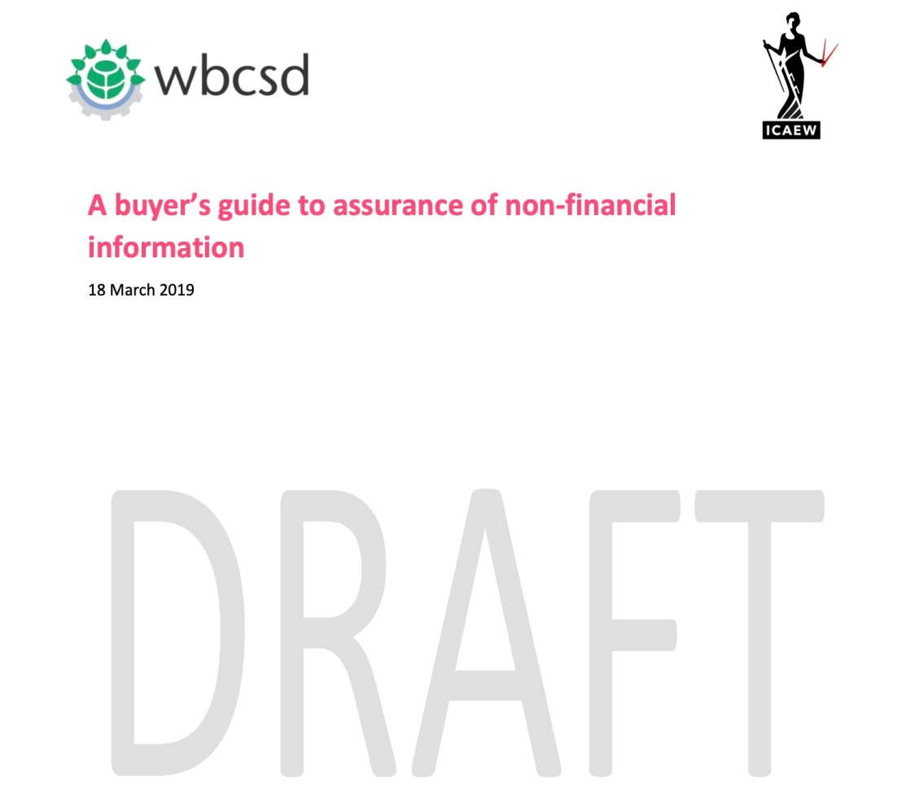
Research - Call to Action
"explain, in simple terms, what assurance is, how the process of assurance works and set out the key considerations for companies seeking to procure assurance services that are ‘fit for purpose."
+
In 2016 the report identified 400 + Sustainability Reporting
Instruments
https://assets.kpmg/content/dam/kpmg/pdf/2016/05/carrots-and-sticks-may-2016.pdf

Slide 20
Thank You!
Liv Watson
Sr. Director of Strategic Customer Initiatives

Slide 21
Liv A. Watson is a Senior Director of Strategic Customer Initiatives at Workiva Inc. (NYSE:WK). Watson recently served as Chair of the Institute of Management Accountants (IMA) Technology Trends Subcommittee, member of the Institute of Chartered Accountants in England and Wales (ICAEW) Sustainability Committee, member of the Global Reporting Initiative (GRI) Technology consortium, and an active member of the XBRL International Funding Task Force.
Watson authored one of the IMA's most successful CPE courses, Accounting System Technology for the 21st Century. She has published numerous articles for international publications and journals, including Harvard Business Review and Strategic Finance. She has also written a monthly column on financial and business reporting trends for CPA2Biz.com. Watson is the co-author and contributing author to several books, including XBRL for Dummies as well as Governance, Risk, and Compliance Handbook published by Wiley. She is also a contributing author of the Harvard Business School’s first e-books titled, The Landscape of Integrated Reporting, and Effective Auditing for Corporations published by Bloomsbury.
She served as an Advisory Board Member to the University of Southern Indiana and the University of Albany. Watson has served as Editorial Board Member for the International Journal of Disclosure and Governance. Watson has been interviewed for a range of business periodicals on the topic of a more efficient business reporting supply chain, including; The Washington Post, Financial Times, Business Week, InformationWeek Wall Street & Technology, and CFO Magazine.
Awards:
Lybrand Certificate of Merit for article titled "XBRL AND THE CLOUD"
Eurofiling Hall of Fame - Recognition to Outstanding Contributors
IMA Global Distinguished Member Award
Lybrand Silver Medal for article titled " Possible Second-Wave Benefits of XBRL"
Certificate of Merit Awarded by IMA - Article "XBRL it Can Improve Today's Business Environment
Liv Watson
Sr. Director of Strategic Customer Initiatives
Workiva Inc. (NYSE: WK)
2900 University Blvd
Ames, IA 50010
Dialpad: (515) 239 4974
Email: liv.watson@workiva.com
Skype: livwatson

